Slide 1
LUL Youth Development and Education Project
JKL Systems

Slide 2
Overview
Team Introduction
Opportunity
Description of a Use Case
Uses Cases
Use Case Diagram
The Next Step

Slide 3
Opportunity
Creating an efficient reporting process, by centralizing data, to increase funding from donations and grants.
Notes:
He asked us to restate the problem, so instead of calling it problem I went with opportunity

Slide 4
Definition
Use Case: a simple description of a system’s function from a high level view
Notes:
This is the best definition I could think of for describing it in laymans terms. If anyone can think of something better feel free to change it

Slide 5
Use Cases
General
Apply for Grants
Process Grants Received
Send Reports
Track Benchmarks
Track Outcomes
Administration of System
Create New Grantor/Donor
Program/Event Specific
Generate Enrollment
Track Student
Generate Reports
Notes:
-General are the use cases for all of LUL
-The specific ones are for each program. So we created those three use cases for each program/event.
*Added the last two and got rid of conduct program

Slide 6
Generate Street Academy Enrollment
1. Use-Case Name – Generate Street Academy Enrollment
1.1 Brief Description
The Parent/Guardian, Program Director, or Assistant Director enrolls student into the Street Academy Program.
2. Flow of Events
2.1 Basic Flow
1. The use case starts when a Parent/Guardian wants to enroll their child into the program.
2. If Parent/Guardian decides to enroll online
2.1 The system requests youth demographics, parent/guardian information, and additional youth information.
2.2 The Parent/Guardian provides the youth demographics, parent/guardian information, and additional youth information.
2.3 The system records the youth demographics, parent/guardian information, and additional youth information.
3. If Parent/Guardian decides to enroll on-site
3.1 Program Director/Assistant Director requests youth demographics, parent/guardian information, and additional youth information.
3.2 The Parent/Guardian provides the youth demographics, parent/guardian information, and additional youth information.
3.3 The Program Director/Assistant Director inputs into system youth demographics, parent/guardian information, and additional youth information.
3.4 The system records the youth demographics, parent/guardian information, and additional youth information.
4. Use case ends
2.2 Alternative Flows
None.
3. Special Requirements
None.
4. Pre-conditions
4.1 Pre-condition
The Street Academy Program has been created within the system.
5. Post-conditions
5.1 Post-condition One
The enrollee’s information has been recorded.
5.2 Post-condition Two
The Parent/Guardian receives confirmation their child has been enrolled, along with a schedule of the program.
6. Extension Points
6.1 Name of Extension Point
Extend: Update existing youth demographics, parent/guardian information, and additional youth information.
Notes:
Use Case 1: Generate enrollment

Slide 7
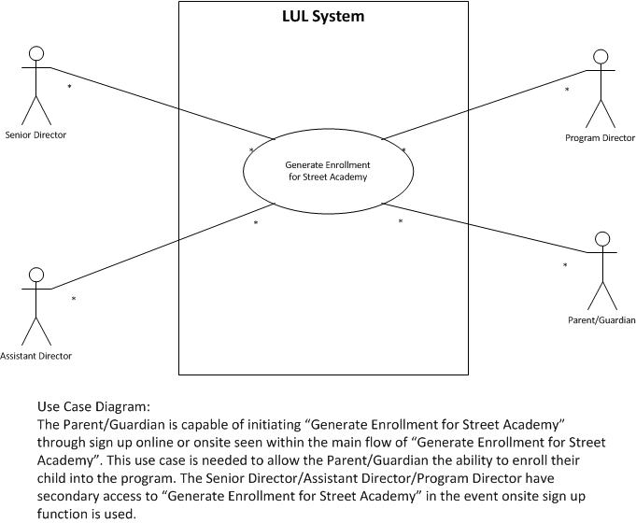
Use Case Diagram
Notes:
Use case diagram for enrolling student

Slide 8
Track Students for Street Academy
1. Use-Case Name – Track Students for Street Academy
1.1 Brief Description
The Program Directors or Assistant Directors will make the program schedule, take attendance, run the
program, and enter attendance records into the system.
2. Flow of Events
2.1 Basic Flow
1. The use case begins when the Program Director chooses to make the schedule for the program.
2. The Students arrive for the Street Academy Program
3. The Students provide their information to the Program Directors.
4. The Program Director records the attendance.
5. The Program Director enters the attendance into the database
6. Use case ends
2.2 Alternative Flows
None
3. Special Requirements
None
4. Pre-conditions
4.1 Pre-condition One
Enrollment for the Street Academy Program has been inputted into the system database.
5. Post-conditions
5.1 Post-condition One
The attendance records have been inputted into the system database.
6. Extension Points
6.1 Extend One
Extend: Update Student information if needed.
Notes:
Use Case 2: track students

Slide 9
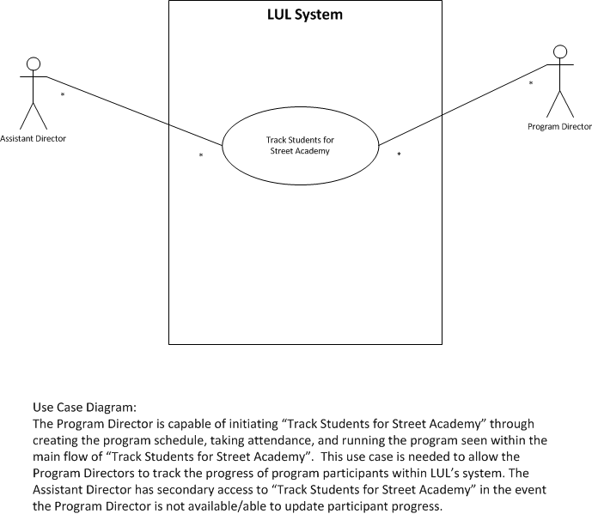
Use Case Diagram
Notes:
Use case diagram for tracking students

Slide 10
Generate Street Academy Reports
1. Use-Case Name – Generate Street Academy Reports
1.1 Brief Description
The Senior Director/Assistant Director inputs requested requirements for report and report is generated.
2. Flow of Events
2.1 Basic Flow
1. The use case starts when the Senior Director/Assistant Director needs to input requested requirements
into reporting system.
2. The system asks for enrollment, program attendance rate, participant satisfaction, benchmarks
achieved, and outcomes achieved.
3. Senior Director/Assistant Director selects information based on request from Donor.
4. The system displays report based on information selected.
5. Use case ends.
2.1 Alternative Flows
None.
3. Special Requirements
None.
4. Pre-conditions
4.1 Pre-condition One
Tracking of Street Academy Program has been completed.
5. Post-conditions
5.1 Post-condition One
The system has displayed report based on information selected.
Notes:
Use Case 3: generate reports….On these use cases he said to show an example…so does that mean I should put the whole use case up like I have? Or should I have just put the bold points?

Slide 11
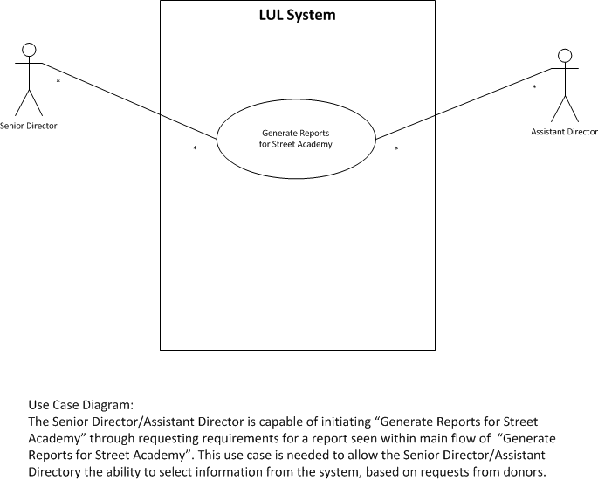
Use Case Diagram

Slide 12
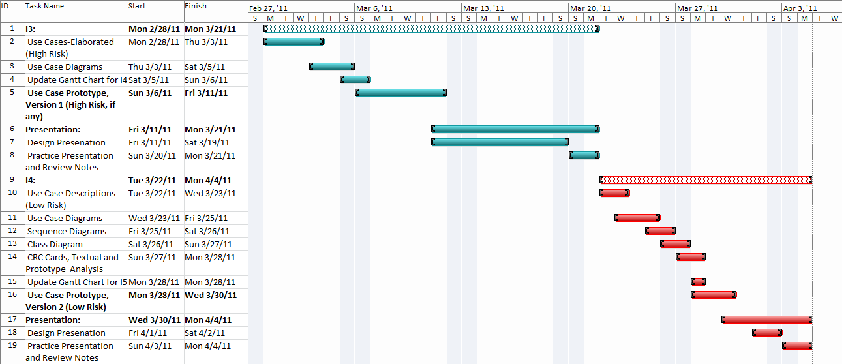
The Next Step: GANTT CHART
Notes:
Low Risk Use cases, class diagrams, sequence diagrams, crc cards, textual and prototype analysis, gantt chart, prototypes

